Slide 1

Air to Water Extraction Using Peltier Device and IoT Based Rover
by
B. Indu
Roll No. 204G1A0540
D. Harshith
Roll No. 204G1A0538
M. Abhigna
Roll No. 204G1A0501
M. Anil Kumar
Roll No. 214G5A0502
M. Badrinath
Roll No. 204G1A0518
Under the guidance of
Mr. G. Chinna Pullaiah M.Tech(Ph.D)
Assistant Professor
Department of Computer Science and Engineering
Srinivasa Ramanujan Institute of Technology
(Autonomous)
2023 - 2024

Slide 2

Contents
<Air to Water Extraction Using Peltier Device and IoT Based Rover>
Review-0 comments
Abstract
Problem statement
Objectives
Literature survey for first objective
Objective-1(Design & Implementation)
Literature survey for second objective
Proposed Work -(Methods to be followed for proposed system)
References
GitHub Link
Queries
A-7

Slide 3
Review-0 Comments
<Air to Water Extraction Using Peltier Device and IoT Based Rover>
Air to Water Extraction Using Peltier Device and IoT Based Rover
Add more links for the literature survey, you have done.
How do you extract water naturally?
Why you choose IoT project instead of your core domain project?
More focus on objectives.
A-7

Slide 4
Abstract
<Air to Water Extraction Using Peltier Device and IoT Based Rover>
Air to Water Extraction Using Peltier Device and IoT Based Rover
In world the several countries are facing problem that to find a water resources for irrigations and etc., more in arid areas. the lack of downfall is causing water insufficiency around the world. If we consider a coastal area we can find sea/ocean but there is problem of drinking water and the such regions has high moisture air. So our project showcases a transformative solution to address water scarcity challenges.
By combining the Peltier Device, Solar energy, Heat sinks and IoT sensors, the project offers a sustainable and scalable approach to secure water resources for vulnerable communities worldwide.
A-7

Slide 5
Problem Statement
<Air to Water Extraction Using Peltier Device and IoT Based Rover>
Air to Water Extraction Using Peltier Device and IoT Based Rover
It is very difficult to get water resources for irrigation due to lack of rainfall.
Water scarcity problem become a major issue. We need to fix it to protect nature and people.
The goal is to create a self-sustaining solution capable of addressing water scarcity in various environments.
A-7

Slide 6
Objectives of Project
<Air to Water Extraction Using Peltier Device and IoT Based Rover>
Air to Water Extraction Using Peltier Device and IoT Based Rover
To obtain a optimal location to extract water using Ground Rover.
To leverage the peltier effect, driven by solar energy, to efficiently extract water vapour from the atmosphere and to target water-stressed regions and remote areas facing challenges in accessing sufficient water resources.
Research Objective: To Enhance agricultural productivity by providing a reliable and consistent water supply for irrigation.
A-7

Slide 7
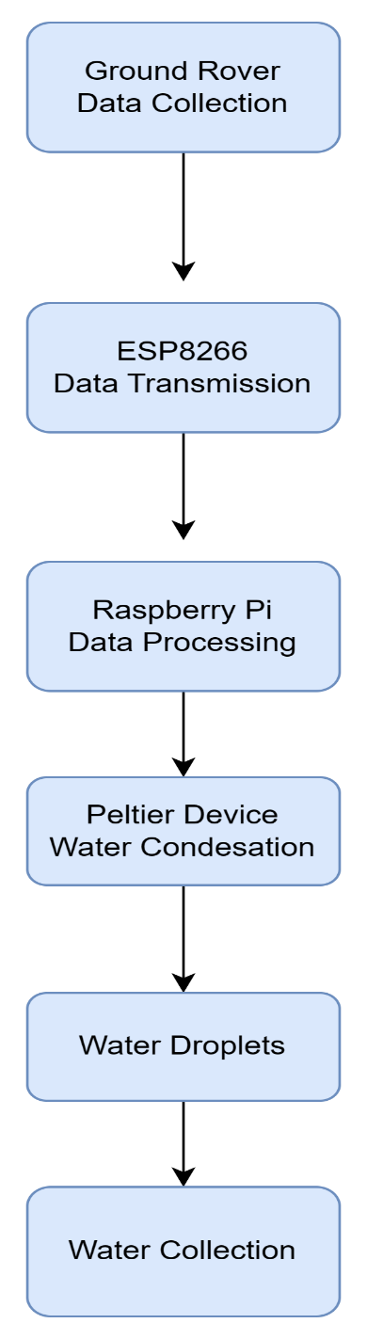
Design and Implementation of Proposed Work
Flowchart:
Flowchart:

Slide 8
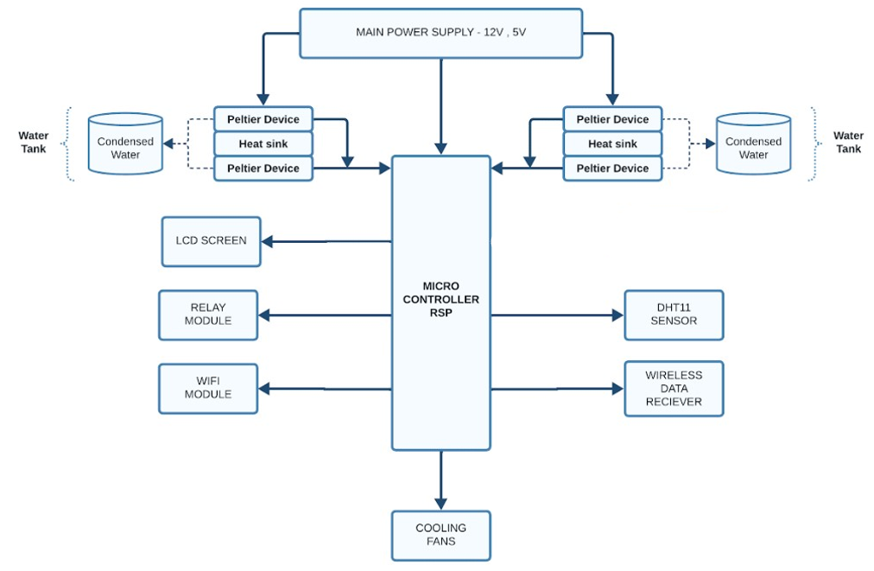
Design and Implementation of Proposed Work
<Air to Water Extraction Using Peltier Device and IoT Based Rover>
Air to Water Extraction Using Peltier Device and IoT Based Rover
Fig1: Block Diagram for Proposed System
A-7

Slide 9
Literature survey for first objective
<Air to Water Extraction Using Peltier Device and IoT Based Rover>
Air to Water Extraction Using Peltier Device and IoT Based Rover
This paper demonstrates the design of transportable water generator based on thermoelectric Peltier to maximize the water generation. The cold side of the model was designed using hydrophobic material. This hydrophobic material increased the condensation rate of air near the cold side of the Peltier. Also, the discharged cool air was passed through the hot side to cool the hot side of the Peltier using latent heat principle. This reusing of cooling energy to remove more heat energy from the hot side maximized the water yield theoretically with minimal energy consumption. Considering all the operating conditions, it was found that the water generation rate increased with the increase in the relative humidity of the air and airflow rates[1].
A-7

Slide 10
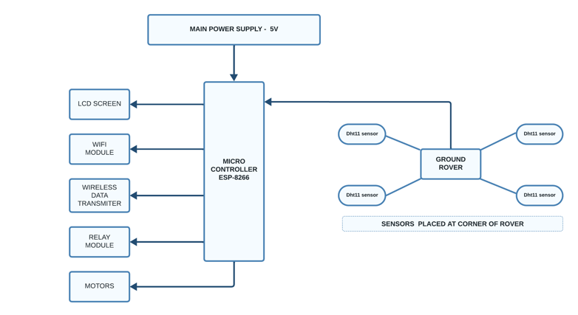
Design and implementation of first Objective
<Air to Water Extraction Using Peltier Device and IoT Based Rover>
Air to Water Extraction Using Peltier Device and IoT Based Rover
Fig 1: Block Diagram for Ground rover with sensors
A-7

Slide 11
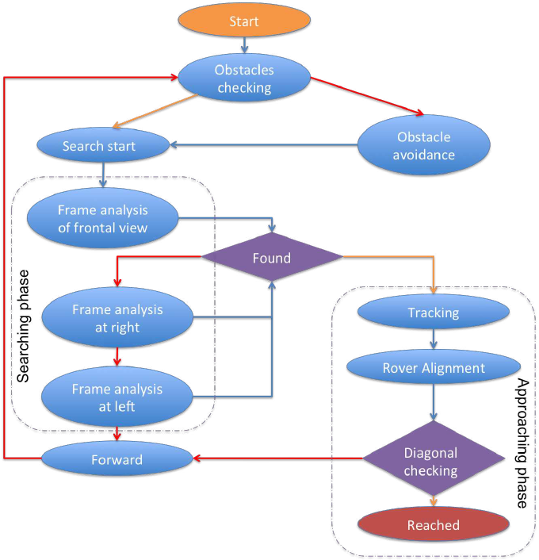
Design and implementation of first Objective
<Air to Water Extraction Using Peltier Device and IoT Based Rover>
Air to Water Extraction Using Peltier Device and IoT Based Rover
Fig2: Flow chart of Ground Rover
A-7

Slide 12
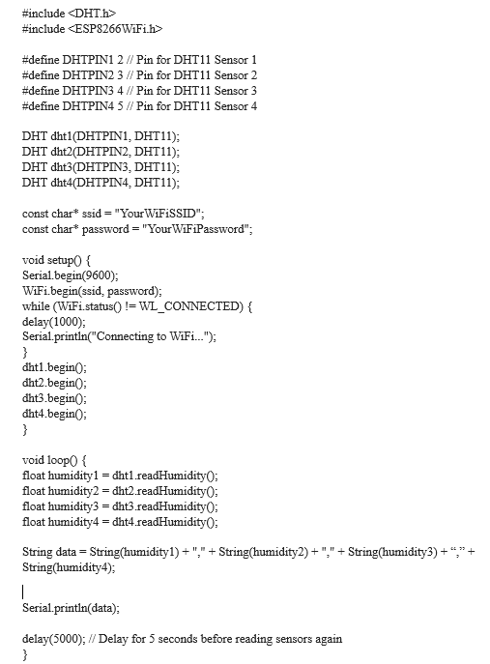
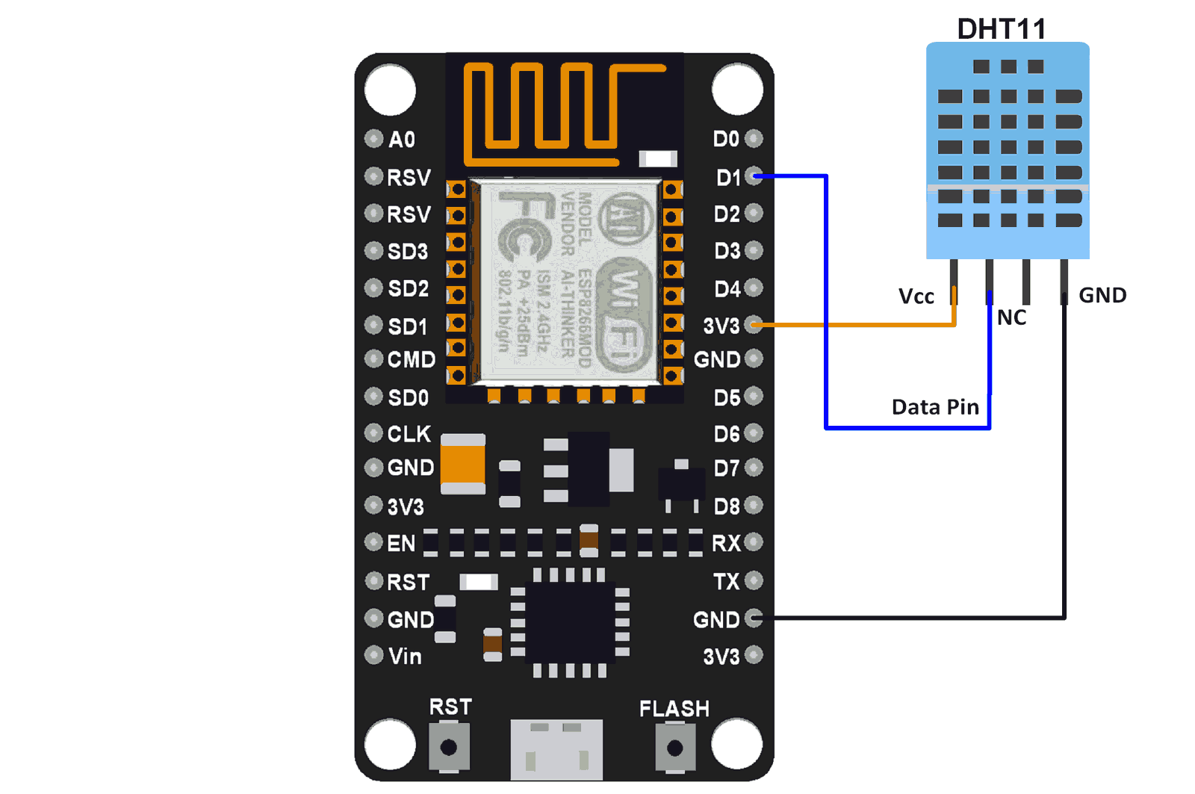
Design and implementation of First Objective
<Air to Water Extraction Using Peltier Device and IoT Based Rover>
Air to Water Extraction Using Peltier Device and IoT Based Rover
Implementation Of DHT 11 Sensor
A-7

Slide 13
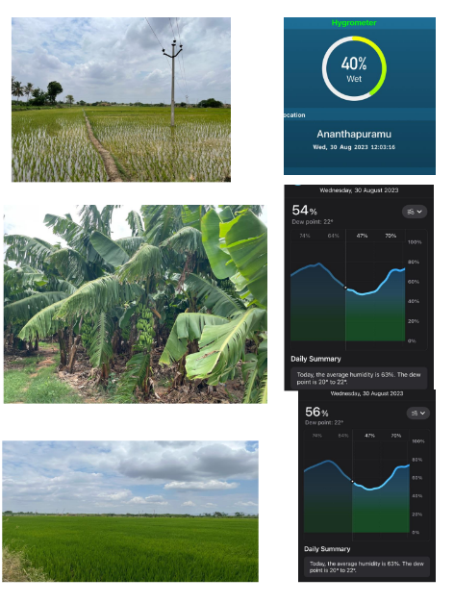
Design and implementation of First Objective
<Air to Water Extraction Using Peltier Device and IoT Based Rover>
Air to Water Extraction Using Peltier Device and IoT Based Rover
DHT11 Sensor Readings – Different Fields
Sapota - 56%-8.6g/kg
Humidity Values - 7.8g/kg
6.6
7.1
8.2
Paddy 78% - 8.8g / kg
Humidity Values - 8.1g / kg
8.3
7.9
8.1
8.4
Banana – 59 % - 7.8g/kg
Humidity Values
5.4g/kg
6.9
7.2
6.8
5.9
A-7

Slide 14
Literature survey for second objective
<Air to Water Extraction Using Peltier Device and IoT Based Rover>
Air to Water Extraction Using Peltier Device and IoT Based Rover
An experimental study of Thermal analysis and optimization of a system for water harvesting from humid air using thermoelectric coolers. They have used sensitivity analysis to find the optimum number of TECs. The resulting system is capable of producing 26 ml of water within 1 h from the air with 75% relative humidity and the temperature of 318 K by consuming only 20 W of electrical power[2].
A-7

Slide 15
Proposed System
<Air to Water Extraction Using Peltier Device and IoT Based Rover>
Air to Water Extraction Using Peltier Device and IoT Based Rover
To overcome the difficulty of the existing system, we will use ground rover which gives a location with high moisture level content to extract more amount of water.
The system uses Bluetooth module for wireless connectivity and the system will monitor the sensor outputs and controls the system.
For Atmospheric Water Generation system consists of the LCD, DHT11 sensor that will measure the humidity and temperature of the surrounding environment and transfer the data to Raspberry Pi 3, which will display humidity and temperature accordingly.
A-7

Slide 16
References
<Air to Water Extraction Using Peltier Device and IoT Based Rover>
Air to Water Extraction Using Peltier Device and IoT Based Rover
[1]. Suresh P S, Charan M S, Chinmay Gansh K, Chirag K R, Harshith G B “Atmospheric Water Generation Using Peltier Effect”, International Research Journal of Modernization in Engineering Technology and Sciences, vol. 3, pp. 539-545,7 July 2021.
[2]. Sachin P R, Rahul Gowda R, Umesh Gangadharmath, Brahmaraj K, Jamuna S , “ Development of Solar Powered Atmosheric Water Generation and Purification System”,International Journal of Creative Research Thoughts(IJCRT), vol. 9, pp. 877-882, 6 June 2021.
[3]. Ramya M, Roja K R, Roopa M, Supritha A, Padma R “Atmoshperic Water Generator using Peltier Device”, International Journal of Engineering Research & Technology(IJERT), vol. 8, pp. 182-185, 2020.
A-7

Slide 17
References
<Air to Water Extraction Using Peltier Device and IoT Based Rover>
Air to Water Extraction Using Peltier Device and IoT Based Rover
[4]. Ms. Vandana, P. Pandya, Dhruv “Overview on Atmospheric Water Generation Technologies” , International Research Journal of Modernization in Engineering Technology and Science(IRJMETS), vol. 3, pp. 1078-1083, 10 October 2021.
[5]. K. Nitheesh, S. Saravanan, A. Ashik Ahamed “Atmospheric Water Generation with the Concept of Peltier Effect” , International Journal of Engineering Research & Technology(IJERT), vol. 7, pp. 1-4, 2019.
A-7

Slide 18
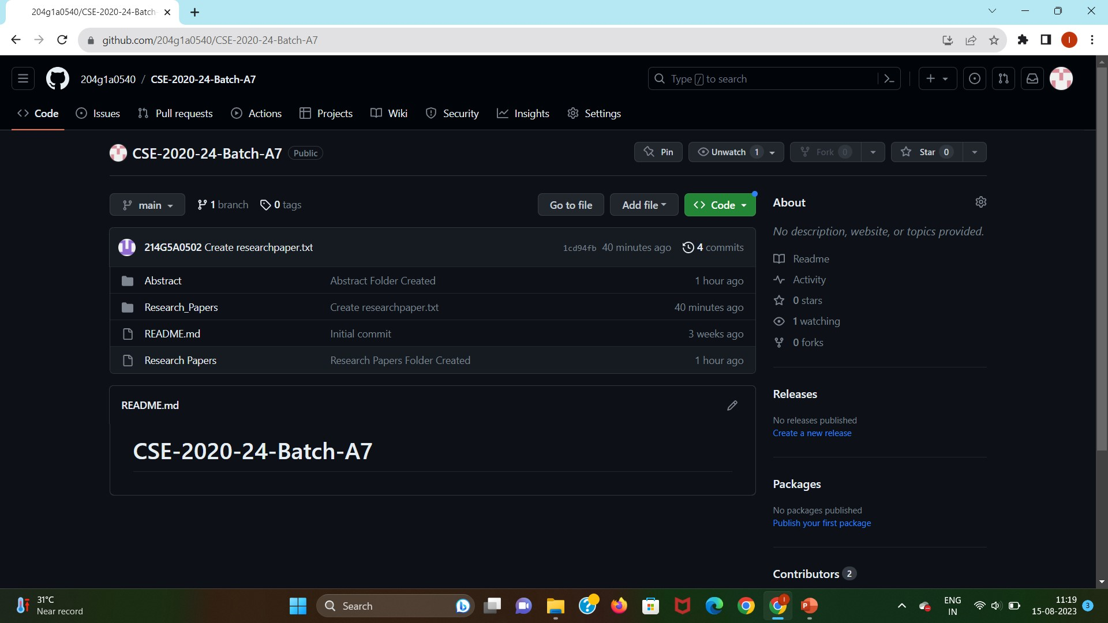
Git Hub Dashboards of each student
<Air to Water Extraction Using Peltier Device and IoT Based Rover>
Air to Water Extraction Using Peltier Device and IoT Based Rover
A-7

Slide 19
<Air to Water Extraction Using Peltier Device and IoT Based Rover>
Any Queries?
A-7

